Slide 1



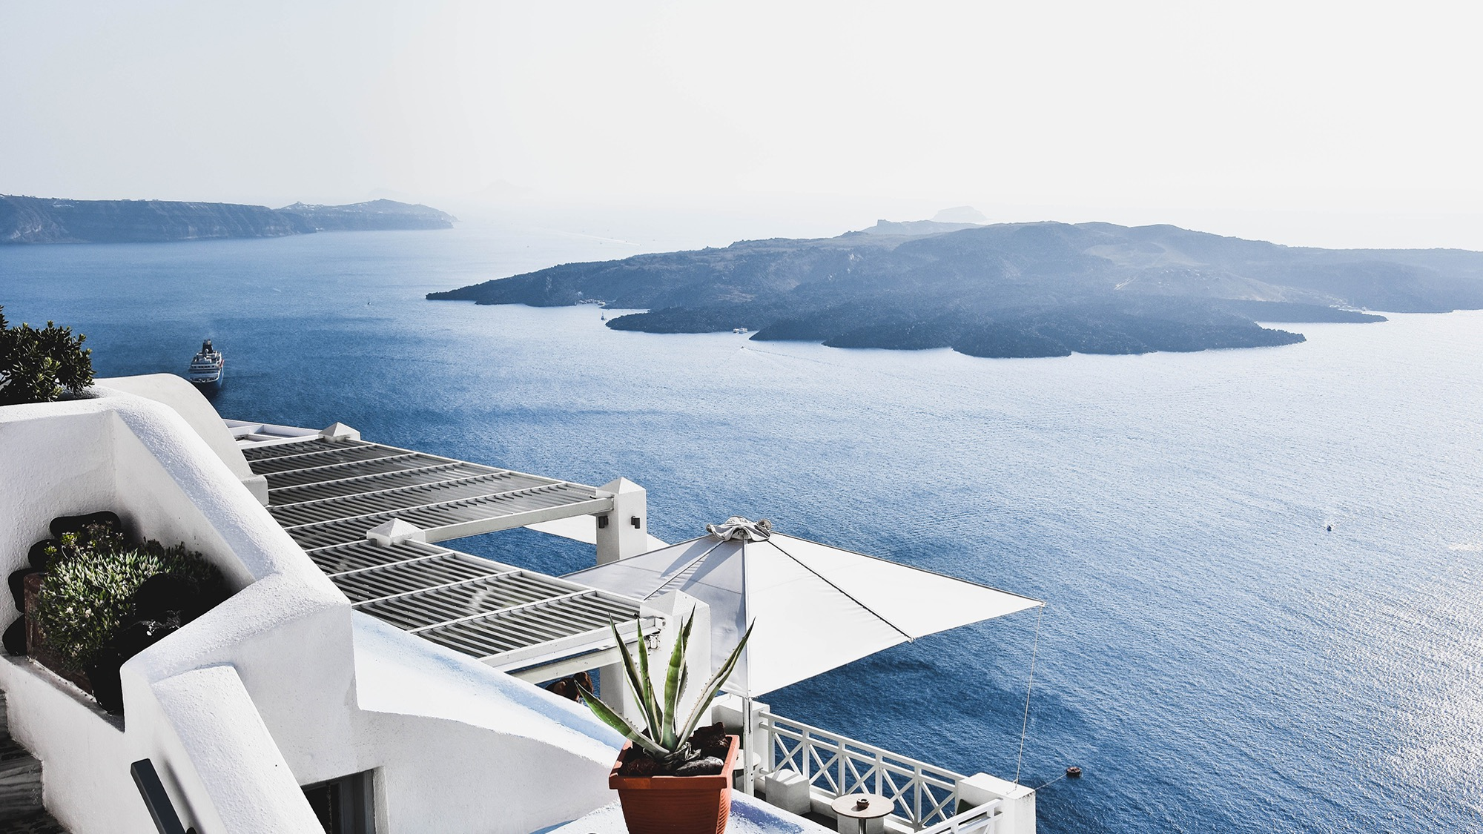
UI
/
UX Design
Rabil Amaril Anwar

Slide 2

Portofolio
This are some project I’ve been workin about ui/ux design using Figma:

Slide 3

1.Hallo Fish
Design Application that I made for my college task, and this application is about us, that thinking about how to help fisher to do their work to becomin more easily.

Slide 4
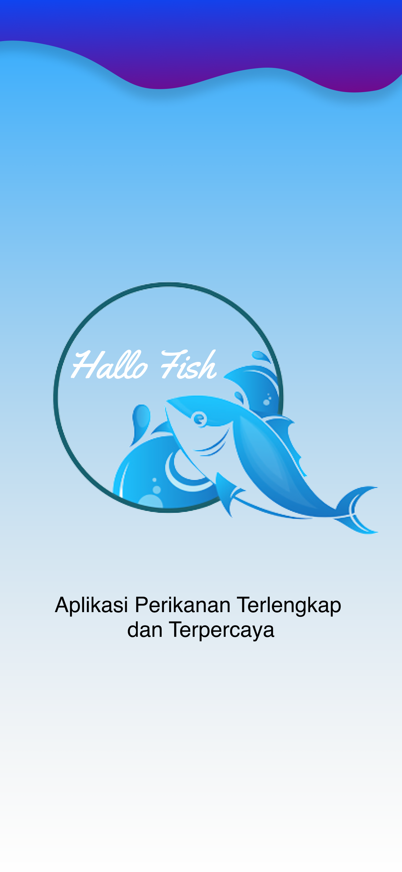
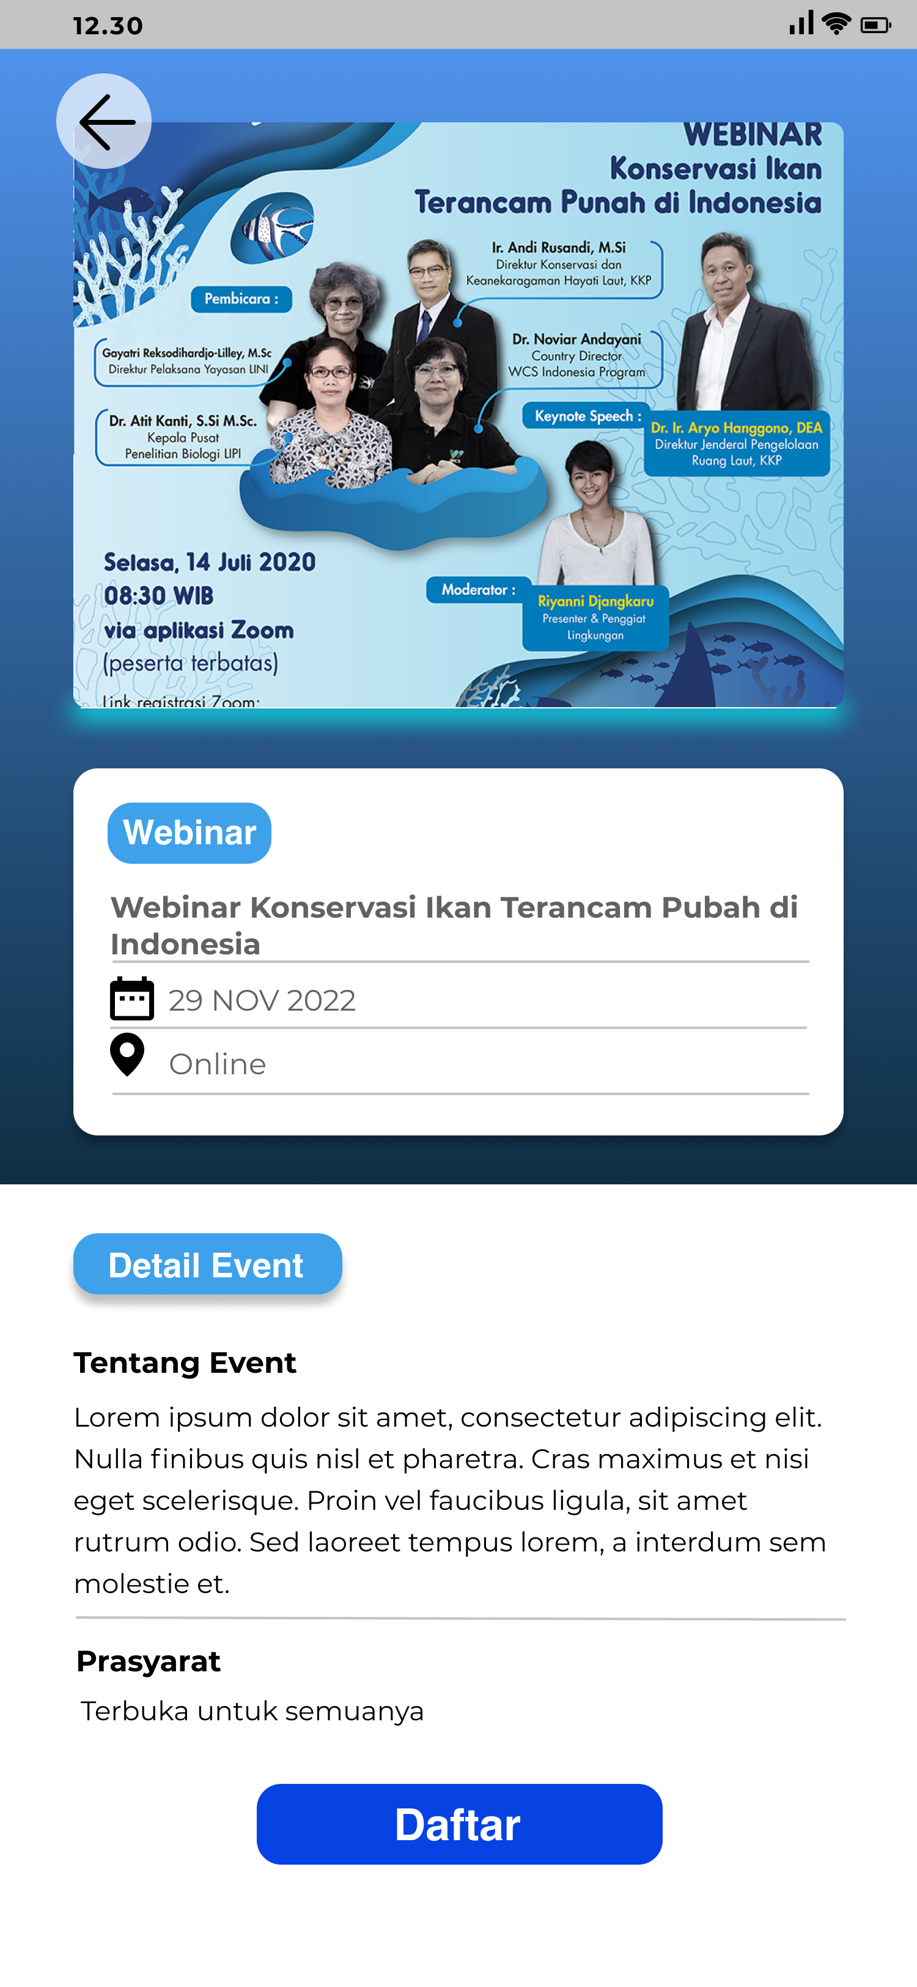
The Project

Slide 5
